Slide 1

Oracle 12c: SQL
Chapter 9
Joining Data from Multiple Tables
©2016. Cengage Learning. All rights reserved.

Slide 2
Objectives
Identify a Cartesian join
Create an equality join using the WHERE clause
Create an equality join using the JOIN keyword
Create a non-equality join using the WHERE clause
Create a non-equality join using the JOIN…ON approach
©2016. Cengage Learning. All rights reserved.

Slide 3
Objectives (continued)
Create a self-join using the WHERE clause
Create a self-join using the JOIN keyword
Distinguish an inner join from an outer join
Create an outer join using the WHERE clause
Create an outer join using the OUTER keyword
Use set operators to combine the results of multiple queries
©2016. Cengage Learning. All rights reserved.

Slide 4
Purpose of Joins
Joins are used to link tables and reconstruct data in a relational database
Joins can be created through:
  Conditions in a WHERE clause
  Use of JOIN keywords in FROM clause
©2016. Cengage Learning. All rights reserved.

Slide 5
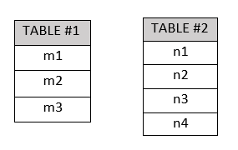
Cartesian Joins
Also called Cartesian product, or cross join
Created by omitting joining condition in the WHERE clause or through CROSS JOIN keywords in the FROM clause
Results in every possible row combination (m * n)
m1*n1
m1*n2
m1*n3
m1*n4
m2*n1
m2*n2
m2*n3
m2*n4
m3*n1
m3*n2
m3*n3
m3*n4

Slide 6
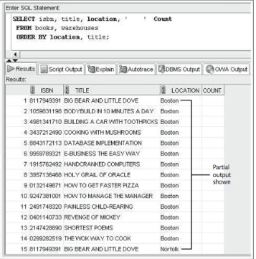
Cartesian Join Example:
JustLee Books needs to perform a manual book inventory in all three of its book warehouses. The manager has requested an inventory sheet listing each book for each warehouse along with a column to record the physical count.
©2016. Cengage Learning. All rights reserved.

Slide 7
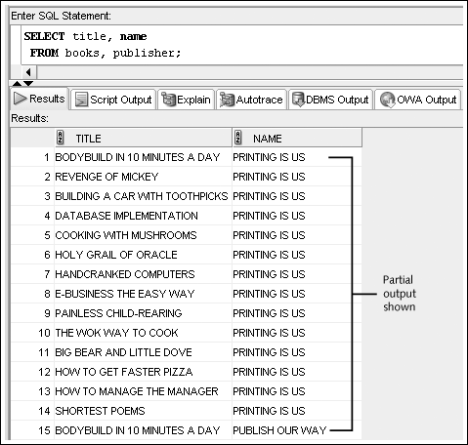
Cartesian Join Example:
Omitted Condition
Suppose you need to find the publisher’s name for each book in inventory.

Slide 8
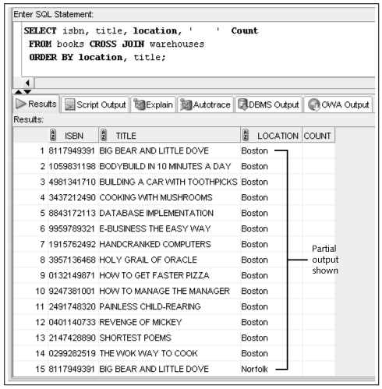
Cartesian Join Example:
CROSS JOIN Keywords

Slide 9
Equality Joins
Sometimes called equijoins, inner joins, or simple joins.
Link rows through equivalent data that exists in both tables
Created by:
    Creating equivalency condition in the WHERE clause
    Using NATURAL JOIN, JOIN…USING, or JOIN…ON keywords in the FROM clause

Slide 10
Equality Joins
A common column is a column with equivalent data existing in two or more tables.
Example
    BOOKS and PUBLISHER tables have Pubid containing an identification code assigned to each Publisher.
Even though common columns typically have the same name, this isn’t a requirement; you can’t depend on column names alone.

Slide 11
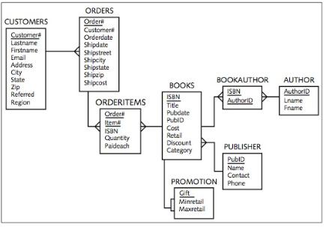
Equality Joins
Each of the one-to-many relationship lines should be supported with a FOREIGN KEY (FK) constraint to ensure consistency of data for common columns.

Slide 12
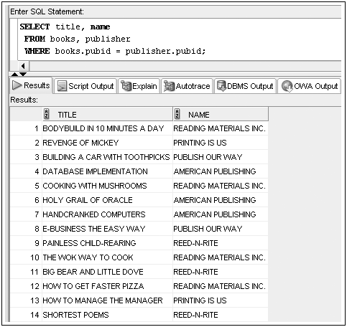
Equality Joins: WHERE Clause Example
The WHERE clause tells Oracle 12c that the BOOKS table and the PUBLISHER table are related by the Pubid column.

Slide 13
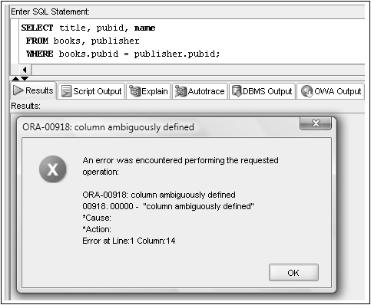
Qualifying Column Names
Columns in both tables must be qualified
©2016. Cengage Learning. All rights reserved.

Slide 14
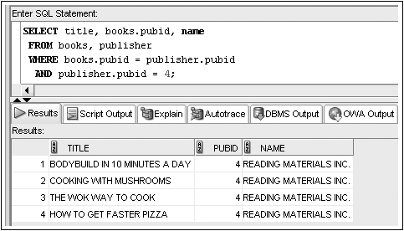
WHERE Clause Supports Join and Other Conditions
©2016. Cengage Learning. All rights reserved.

Slide 15
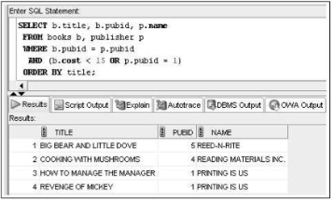
WHERE Clause Supports Join and Other Conditions
©2016. Cengage Learning. All rights reserved.

Slide 16
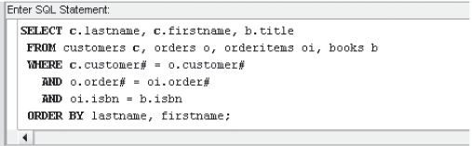
Joining More Than Two Tables
Joining four tables requires three join conditions
©2016. Cengage Learning. All rights reserved.

Slide 17
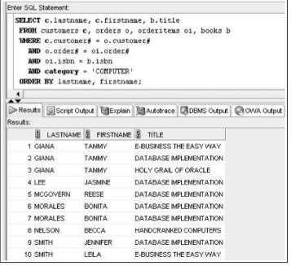
Joining More Than Two Tables
©2016. Cengage Learning. All rights reserved.

Slide 18

Equality Joins: NATURAL JOIN
The NATURAL JOIN keywords create a join automatically between two tables, based on columns with matching names.
©2016. Cengage Learning. All rights reserved.

Slide 19
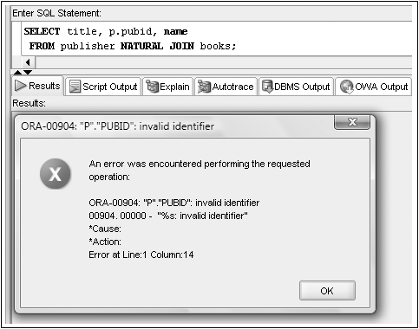
No Qualifiers with a NATURAL JOIN
Because both the BOOKS and the PUBLISHER tables contain the Pubid column, this column is a common column and should be used to relate the two tables.
When using the NATURAL JOIN keywords, you aren’t required to specify columns the two tables have in common. The NATURAL keyword implies that the two specified tables have at least one column in common with the same name and contain the same datatype.

Slide 20

Equality Joins: JOIN…USING
The USING clause allows you to create joins based on a column that has the same name and definition in both table
A column referenced by a USING clause can’t contain a column qualifier anywhere in the SELECT statement.
©2016. Cengage Learning. All rights reserved.

Slide 21

Equality Joins: JOIN…ON
When the tables to be joined in a USING clause don’t have a commonly named and defined field, you must add the ON clause to the JOIN keyword to specify how the tables are related.
Required if column names are different
©2016. Cengage Learning. All rights reserved.

Slide 22
JOIN Keyword Overview
Use JOIN…USING when tables have one or more columns in common
Use JOIN…ON when same named columns are not involved or a condition is needed to specify a relationship other than equivalency (next section)
Using the JOIN keyword frees the WHERE clause for exclusive use in restricting rows
©2016. Cengage Learning. All rights reserved.

Slide 23
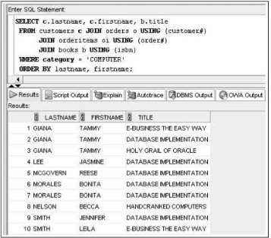
JOIN Keyword Overview

Slide 24
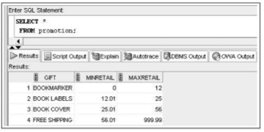
Non-Equality Joins
In WHERE clause, use any comparison operator other than the equal sign
In FROM clause, use JOIN…ON keywords with a non-equivalent condition

Slide 25

Non-Equality Joins: WHERE Clause Example
Because the rows in the BOOKS and PROMOTION tables don’t contain equivalent values, you must use a non-equality join to determine which gift a customer receives during the promotion
The BETWEEN operator is used in the WHERE clause to determine the range in which a book’s retail price falls
©2016. Cengage Learning. All rights reserved.

Slide 26

Non-Equality Joins: JOIN…ON Example
A non-equality join using the JOIN keyword has the same syntax as an equality join with the JOIN keyword. The only difference is that an equal sign isn’t used to establish the relationship in the ON clause.
©2016. Cengage Learning. All rights reserved.

Slide 27
Self-Joins
Used to link a table to itself
Requires the use of table aliases
Requires the use of a column qualifier
©2016. Cengage Learning. All rights reserved.

Slide 28
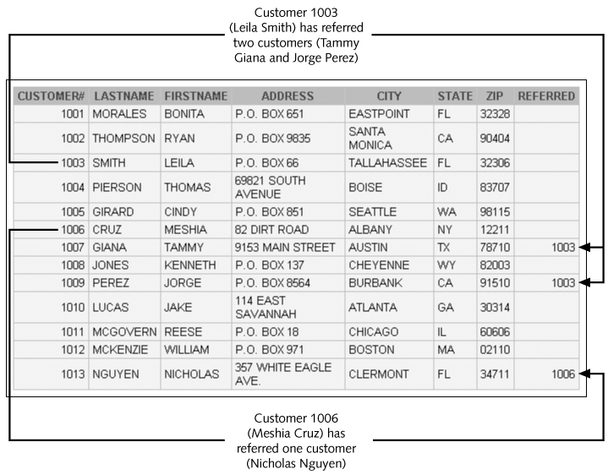
Customer Table Example
©2016. Cengage Learning. All rights reserved.

Slide 29
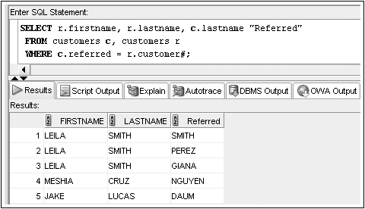
Self-Joins: WHERE Clause Example
©2016. Cengage Learning. All rights reserved.

Slide 30
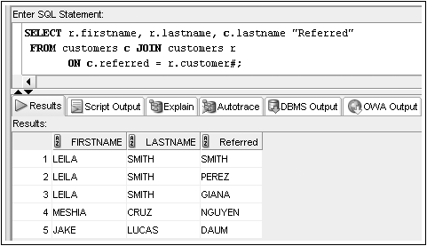
Self-Joins: JOIN…ON Example
Regardless of the method used, the concept behind a self-join is the same—to use table aliases to make it appear that you’re joining two different tables. Use the same example. . .
©2016. Cengage Learning. All rights reserved.

Slide 31
Outer Joins
In the joins used so far, a row is returned only if a corresponding record in each table is queried. These types of joins can be categorized as inner joins because records are listed in the results only if a match is found in each table.
Suppose you want a list of all customers (not just ones who’ve placed an order) and order numbers for orders the customers have recently placed
©2016. Cengage Learning. All rights reserved.

Slide 32
Outer Joins
Use outer joins to include rows that do not have a match in the other table
In WHERE clause, include outer join operator (+) immediately after the column name of the table with missing rows to add NULL rows
In FROM clause, use FULL, LEFT, or RIGHT with OUTER JOIN keywords
©2016. Cengage Learning. All rights reserved.

Slide 33
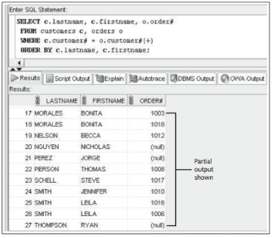
Outer Joins: WHERE Clause Example
©2016. Cengage Learning. All rights reserved.

Slide 34
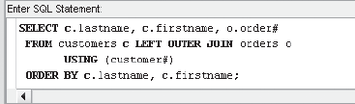
Outer Joins: OUTER JOIN Keyword Example
©2016. Cengage Learning. All rights reserved.

Slide 35
Outer Joins (continued)
If multiple join conditions are used, the outer join condition may be required in all of the join conditions to retain nonmatching rows
©2016. Cengage Learning. All rights reserved.

Slide 36
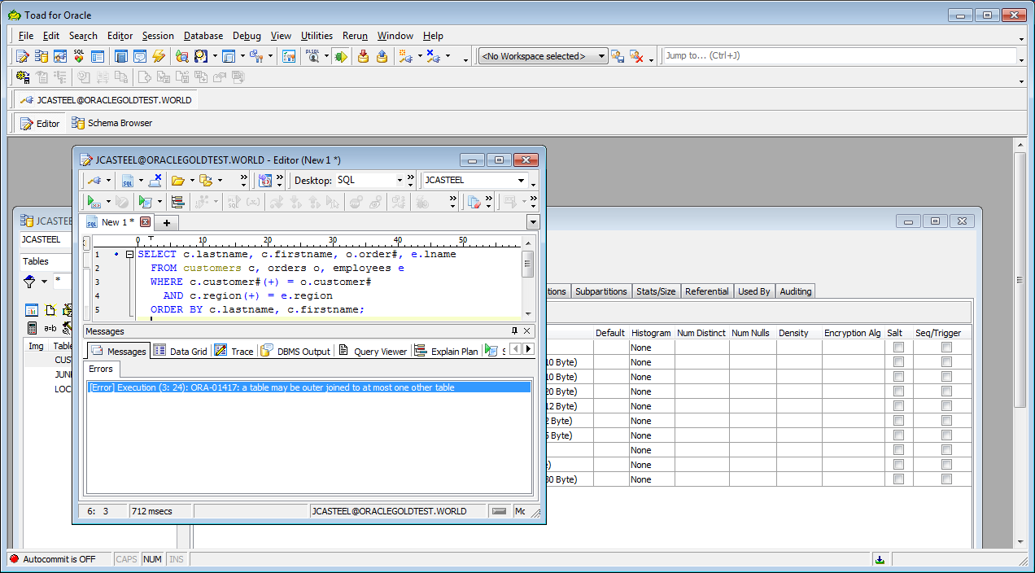
Outer Joins (continued)
In previous versions of Oracle an error would be raised if the outer join operator is used on the same table in more than one join operation
©2016. Cengage Learning. All rights reserved.

Slide 37
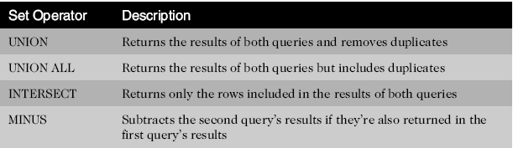
Set Operators
Used to combine the results of two or more SELECT statements
©2016. Cengage Learning. All rights reserved.

Slide 38
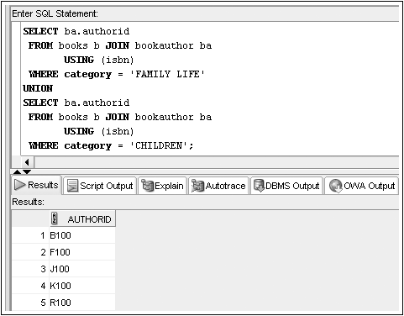
Set Operators: UNION Example
©2016. Cengage Learning. All rights reserved.

Slide 39
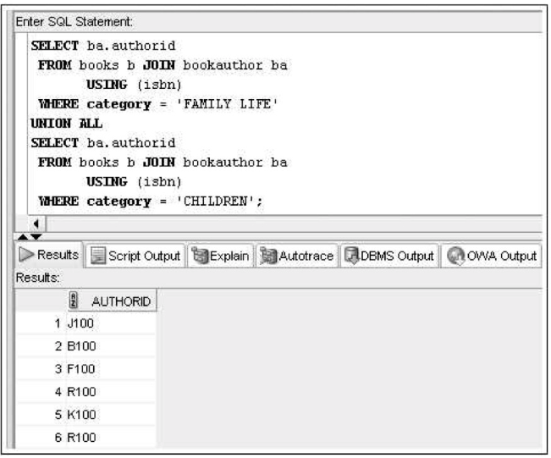
Set Operators: UNION Example
Unlike the UNION set operator, the UNION ALL set operator displays every row returned by the combined SELECT statements.
©2016. Cengage Learning. All rights reserved.

Slide 40
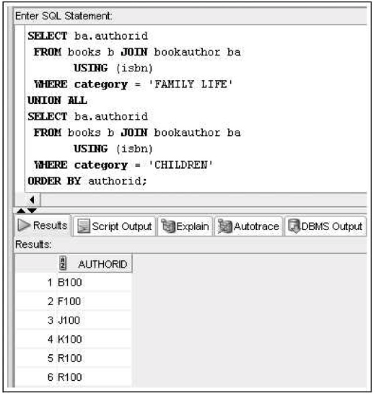
Set Operators: UNION Example
The output can be improved with sorting, which can be added to set operations by including an ORDER BY clause at the end
©2016. Cengage Learning. All rights reserved.

Slide 41
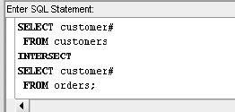
Set Operators: INTERSECT Example
By using the INTERSECT set operator to combine the two SELECT statements, you instruct Oracle to list all customers who have placed an order recently and who exist in the CUSTOMERS table. Only customers who are retrieved in both SELECTS should be in the results
©2016. Cengage Learning. All rights reserved.

Slide 42
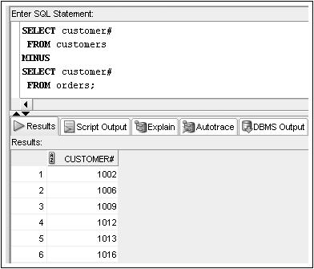
Set Operators: MINUS Example
We could request a list of customer numbers for customers who are stored in the CUSTOMERS table but haven’t placed an order recently

Slide 43
Summary
Data stored in multiple tables regarding a single entity can be linked together through the use of joins
A Cartesian join between two tables returns every possible combination of rows from the tables; the resulting number of rows is always m * n
An equality join is created when the data joining the records from two different tables are an exact match
A non-equality join establishes a relationship based upon anything other than an equal condition
Self-joins are used when a table must be joined to itself to retrieve needed data
©2016. Cengage Learning. All rights reserved.

Slide 44
Summary (continued)
Inner joins are categorized as being equality, non-equality, or self-joins
An outer join is created when records need to be included in the results without having corresponding records in the join tables
  The record is matched with a NULL record so it will be included in the output
Set operators such as UNION, UNION ALL, INTERSECT, and MINUS can be used to combine the results of multiple queries
©2016. Cengage Learning. All rights reserved.

